Slide 1
Azure AD Connect – Architecture Explained
M365 – MS 100
Notes:
Importance planning

Slide 2
Topics
Azure AD Connect Architecture
Synchronization demo
Notes:
Picture

Slide 3
Azure AD Connect
Azure AD Connect is the Microsoft tool designed to meet and accomplish your hybrid identity goals.
PHS
PTA
Federation Integration
Synchronization
Health Monitoring

Slide 4
Azure AD Connect Sync
Azure Active Directory Connect synchronization services
Synchronize identity data between your on-premises environment and Azure AD
Azure AD Connect sync is the successor of DirSync, Azure AD Sync, and Forefront Identity Manager

Slide 5

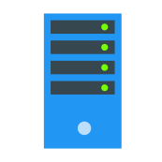






Azure AD Connect Sync
Import - import data from multiple connected data sources
Sync – Sync and process rules
Export – Export results to directories
Sync Engine
On-Prem Directory
Azure AD
Inbound / Outbound Rules
Copy of user
On-premises users

Slide 6
Azure AD Connect Sync
Data Source : Azure AD and On-prem AD
Connector: tenant.onmicrosoft.com & domain.com
Data Source
Data Source
Active Directory Connector Space
Metaverse
Azure AD
Connector Space
On-Prem Directory
Azure AD
On-premises users
Copy of user
Connector
Cloud-labs.online
Connector
M365proguideon.onmicrosoft.com

Slide 7
Azure AD Connect Sync
sync engine uses the connector space to determine what has changed in the connected data source and to stage incoming changes.
Active Directory Connector Space
Metaverse
Azure AD
Connector Space
On-Prem Directory
Azure AD
On-premises users
Copy of user

Slide 8
Sync Engine Identity Management Process
Import – Changes imported to Connector Space
Synchronization – Sync to Metaverse
Export – Changes Exported to Directories

Slide 9



Step 1: Import
Active Directory Connector Space
Metaverse
Azure AD
Connector Space
Domain Controller
Azure AD
Copy of user
On-premises users
Import

Slide 10
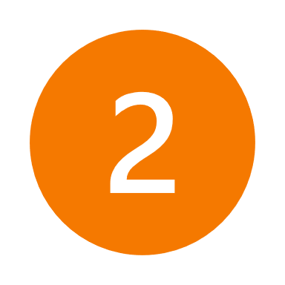
Step 2: Synch
Outbound Rule
Outbound Rule
123
Inbound Rule
Outbound Rule
Active Directory Connector Space
Metaverse
Azure AD
Connector Space
Domain Controller
Azure AD
Copy of user
On-premises users
Import
Sync

Slide 11

Step 3: Export
Outbound Rule
Outbound Rule
123
Inbound Rule
Outbound Rule
Active Directory Connector Space
Metaverse
Azure AD
Connector Space
Domain Controller
Azure AD
On-premises users
Import
Sync
Export

Slide 12
Azure AD Connect Sync
123
Active Directory Connector Space
Metaverse
Azure AD
Connector Space
On-Prem Directory
Azure AD
Copy of user
On-premises users

Slide 13
Demo
Create a User and Export to Azure AD Step by Step

Slide 14
Next Video
Hybrid Identity Model
Password hash synchronization
Pass-through authentication
Federated authentication
Summary
Azure AD Connect

Slide 15
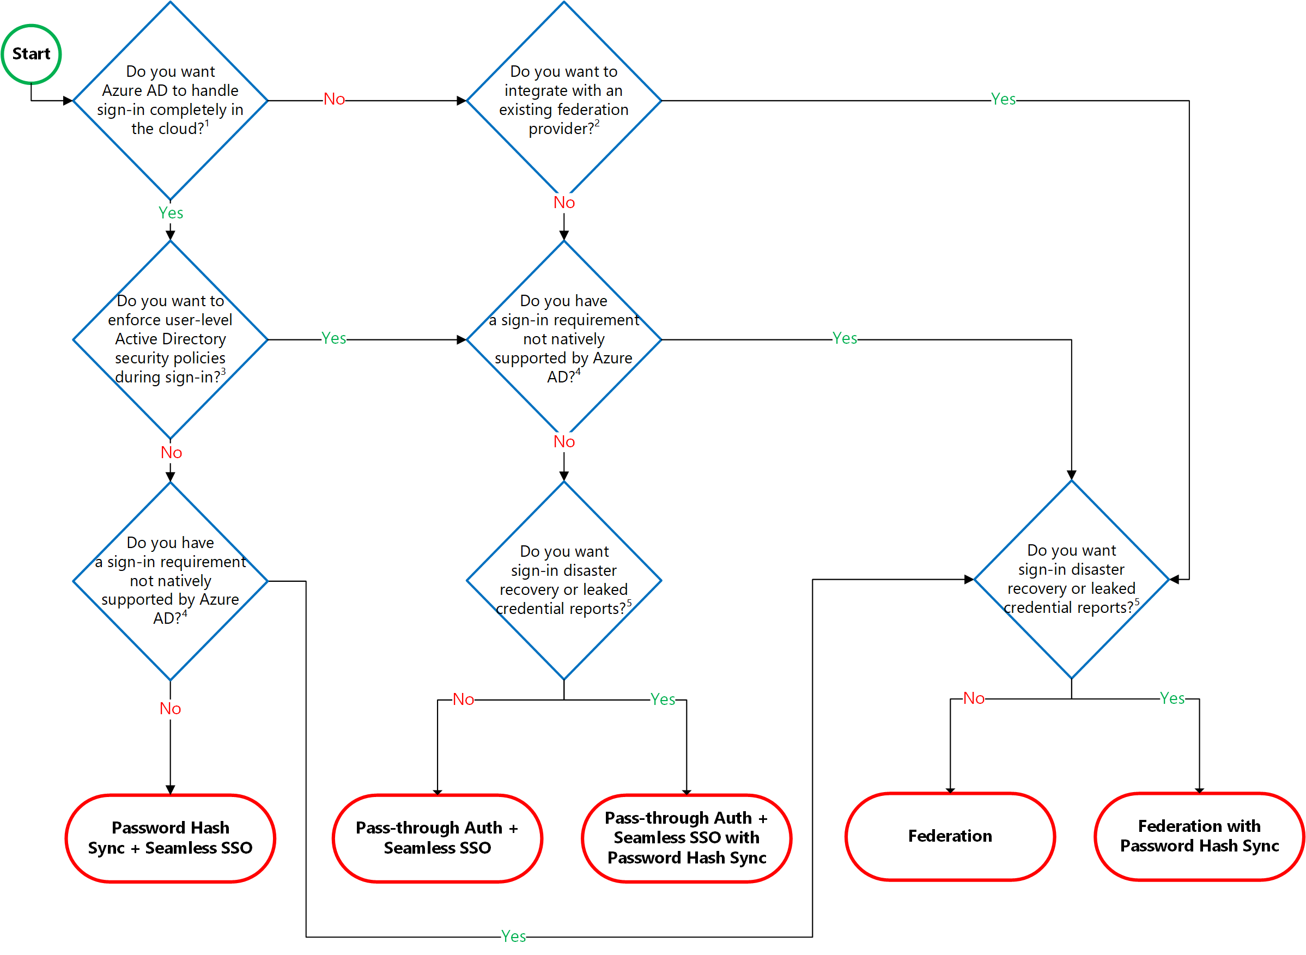
Decision Tree

